Slide 1



Logistic Regression Model Deep Dive

Slide 2
Logistic Regression
Regression
Supervised Learning
Classification
Logistic Regression
Predicting binary Values (Yes/ No)

Slide 3
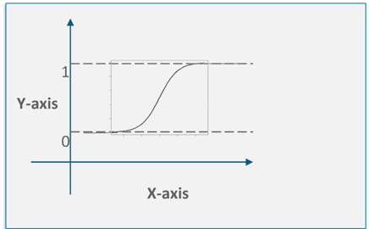
Supervised Learning : Logistic Regression
What is Logistic Regression?:
Logistic regression is used to get and analyze the relationship between one dependent binary variable and one or more nominal, ordinal, interval or ratio-level independent variables.
When to use Logistic Regression?
To predict an outcome variable that is categorical from one or more categorical or continuous predictor variables.
when we have a categorical outcome variable violates the assumption of linearity in normal regression.
Linear Regression cannot be used when we get a curve which is not linear.

Slide 4
Supervised Learning : Logistic Regression
Probability and Odds:
Probability is the number of times success occurred compared to the total number of trials.
Odds are the number of times success occurred compared to the number of times failure occurred.
Number of Successes
If Probability of success = P(Success) =
Total Number of Trials
Number of Successes P(Success)
Then Odd (Success) = =
Number of Failures 1 – P(Success)
Logit:
The logit function is the natural log of the odds that Y equals one of the categories
P(Success)
logit = ln ( )
1 – P(Success)

Slide 5
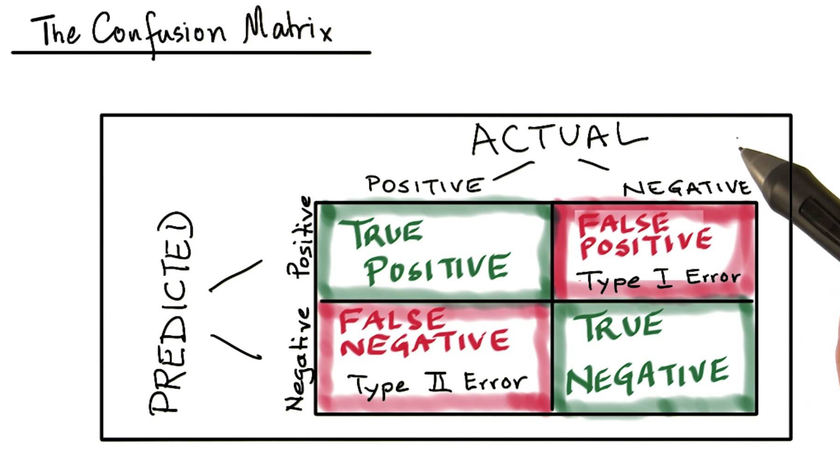
Supervised Learning : Logistic Regression
Confusion Matrix:
The confusion matrix is a tabular representation of Actual Vs Prediction. A sample confusion matrix is given below

Slide 6


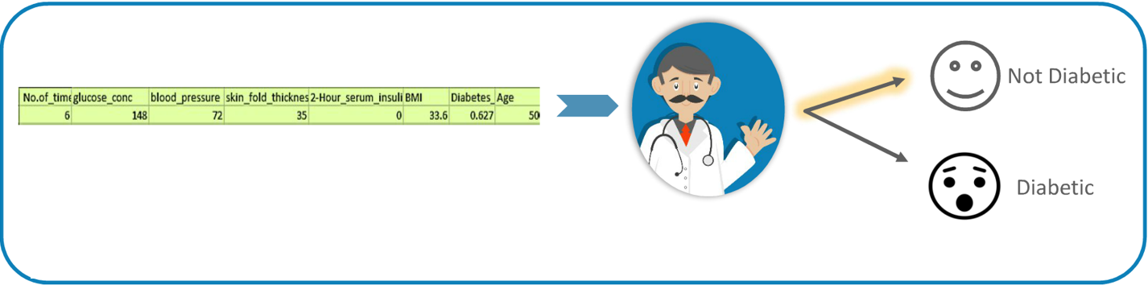
Illustration
Patient: I want to get diagnosed for Diabetes.
Doctor: Ok Let me check the report
After analyzing the patient’s report, the doctor with the help of his experience can diagnose whether the patient has diabetes or not

Slide 7
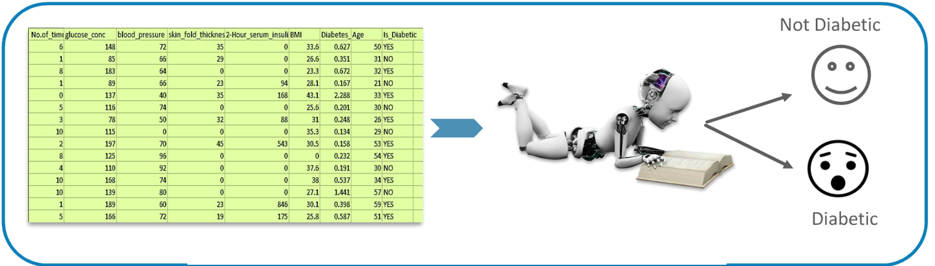
Illustration
We now want to train a machine to do the Doctor’s task. For this purpose we have to train the machine with the same experience / Knowledge using the historical data.
Machine Learning from the historical data of 50000 patients

Slide 8
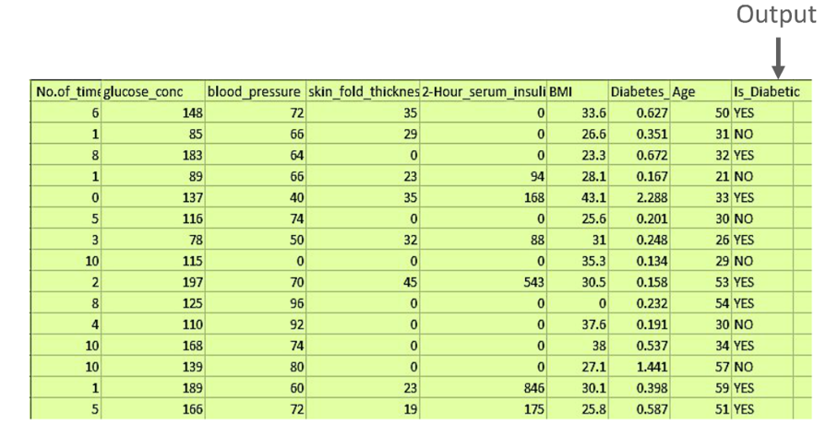
Illustration
The problem has following characteristics:
Labelled learning data and output is available
We have historical data using which machine can find the relationship between the input and output.
Output classes are predefined
i.e. Diabetic or not Diabetic

Slide 9
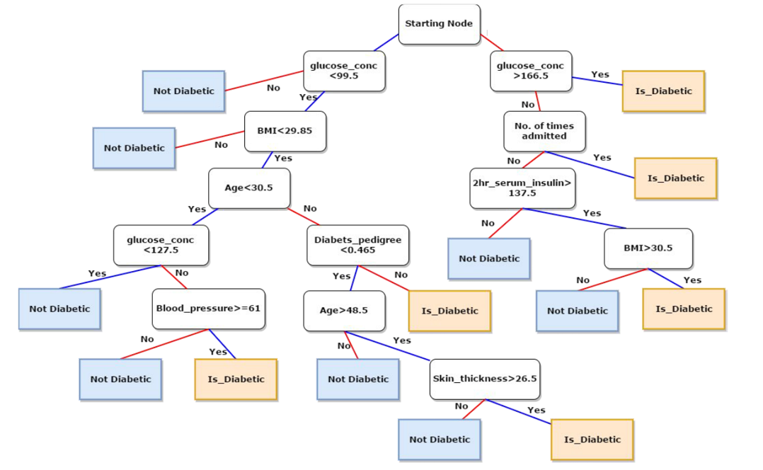
Illustration
After learning from the training data, machine will create certain rules / model as depicted by this flow graph.

Slide 10
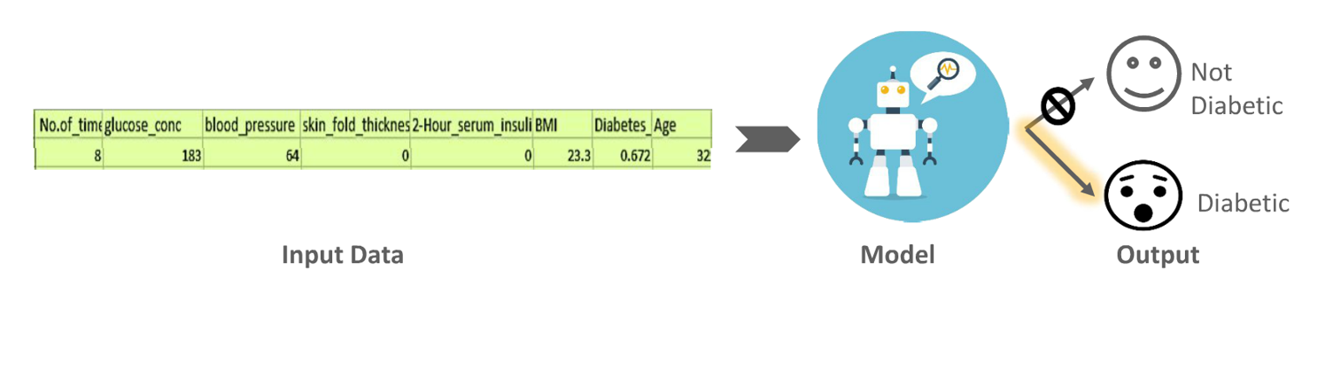
Illustration
Based upon the model created from the training data, the machine is now able to classify into predefined classes, which is in this case are diabetic or not diabetic.

Slide 11
Sample Use Cases Logistics Regression Classifying Cancer Patients as Benign or Malignant (Logistics Regression)

Slide 12
Agenda
Challenge / Problem Statement (Sample)
Pre-Modelling Analysis
Inspect the Structure of Variables
Data Type Conversion
Handling Class Imbalance
Classification Modelling
Train a Logistics Regression Model
Fit the Model & Summarize
Predict from the Testing Data Set
Check Accuracy (Confusion Matrix)
Check Accuracy (ROC Plot)
Analytics Insights / Results (Sample)
Q&A

Slide 13
Challenge / Problem Statement (Sample)
The Data set is taken from “Wisconsin Breast Cancer Database” (http://ugrad.stat.ubc.ca/R/library/mlbench/html/BreastCancer.html)
The challenge is to identify each of a number of cases as “benign or malignant” classes.
Samples arrive periodically as Dr. Wolberg reports his clinical cases.
The database therefore reflects this chronological grouping of the data.

Slide 14
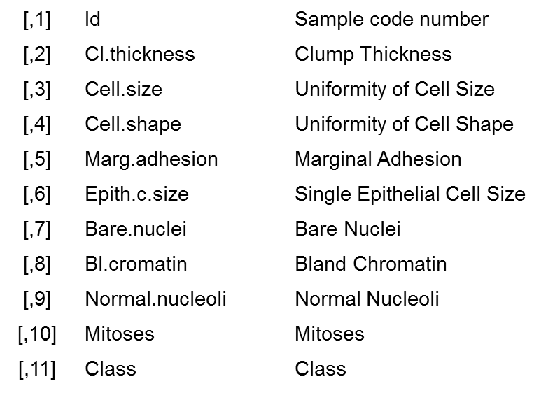
Pre Modelling – Breast Cancer Dataset - Data description
This grouping information appears immediately below, having been removed from the data itself.
Each variable except for the first was converted into 11 primitive numerical attributes with values ranging from 0 through 10.
There are 16 missing attribute values.

Slide 15
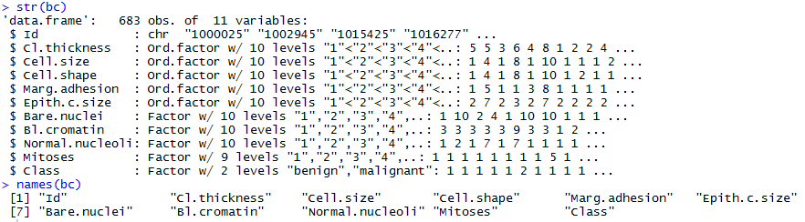
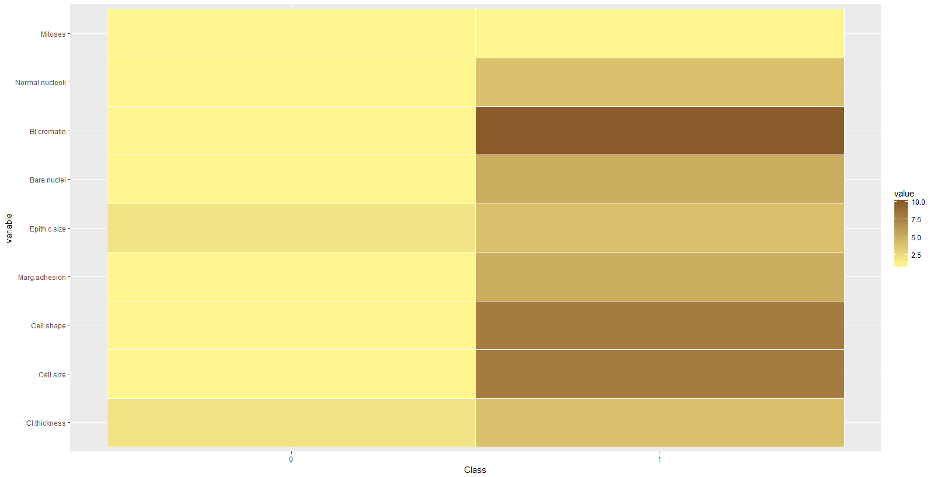
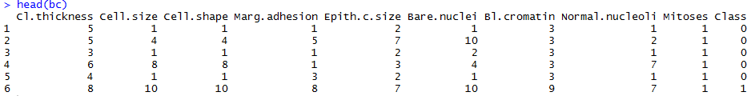
Exploratory Analysis

Slide 16
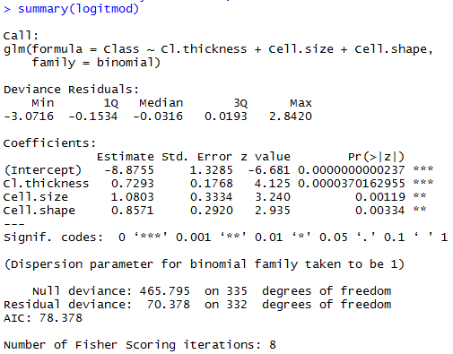
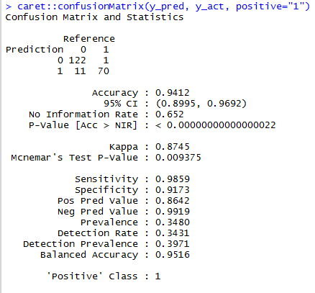
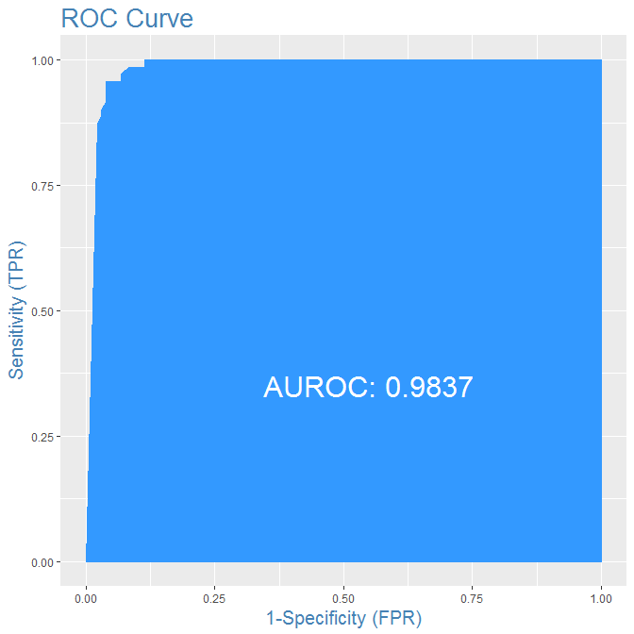
Logistic Model – Results
Below table explains, Logistic Regression equation arrived to predict the probability of Breast Cancer Event for each observations. Probability cut-off taken as 0.5, if there is an Event or Not.
Below table explains, "Confusion Matrix" reveals a lot of Information about "Accuracy of Model“. Sensitivity explains the “Proportion of "Actual Events" that "Model" Predicted as an Event and Specificity explains the “Proportion of "NOT Events" that "Model" predicted correctly”
Note: Downsampling method has been used here to handle the imbalance in the “Class” variable (0&1), however there are other two sampling methods (Upsampling and hybrid) also available

Slide 17
Analytics Insights
Cl Thickness, Cell Size and Cell Shape are the significant variables to predict Breast Cancer Class as “malignant (1)” or “benign (0)”
Accuracy of predicting Breast cancer event is as good as 94%

